Slide 1
Scripture Reading / 读 经
Ruth / 路得记 1:1-22

Slide 2
1:1 当士师秉政的时候，国中遭遇饥荒。在犹大的伯利恒，有一个人带着妻子和两个儿子往摩押地去寄居。
In the days when the judges ruled there was a famine in the land, and a man of Bethlehem in Judah went to sojourn in the country of Moab, he and his wife and his two sons.

Slide 3
1:2 这人名叫以利米勒，他的妻名叫拿俄米；他两个儿子，一个名叫玛伦，一个名叫基连，都是犹大伯利恒的以法他人。他们到了摩押地，就住在那里。
The name of the man was Elimelech and the name of his wife Naomi, and the names of his two sons were Mahlon and Chilion. They were Ephrathites from Bethlehem in Judah. They went into the country of Moab and remained there.

Slide 4
1:3 后来拿俄米的丈夫以利米勒死了，剩下妇人和她两个儿子。
But Elimelech, the husband of Naomi, died, and she was left with her two sons.

Slide 5
1:4 这两个儿子娶了摩押女子为妻，一个名叫俄珥巴，一个名叫路得，在那里住了约有十年。
These took Moabite wives; the name of the one was Orpah and the name of the other Ruth. They lived there about ten years,

Slide 6
1:5 玛伦和基连二人也死了，剩下拿俄米，没有丈夫，也没有儿子。
and both Mahlon and Chilion died, so that the woman was left without her two sons and her husband.

Slide 7
1:6 她就与两个儿妇起身，要从摩押地归回；因为她在摩押地听见耶和华眷顾自己的百姓，赐粮食与他们。
Then she arose with her daughters-in-law to return from the country of Moab, for she had heard in the fields of Moab that the LORD had visited his people and given them food.

Slide 8
1:7 于是她和两个儿妇起行离开所住的地方，要回犹大地去。
So she set out from the place where she was with her two daughters-in-law, and they went on the way to return to the land of Judah.

Slide 9
1:8 拿俄米对两个儿妇说：「你们各人回娘家去吧。愿耶和华恩待你们，像你们恩待已死的人与我一样！
But Naomi said to her two daughters-in-law, “Go, return each of you to her mother's house. May the LORD deal kindly with you, as you have dealt with the dead and with me.

Slide 10
1:9 愿耶和华使你们各在新夫家中得平安！」于是拿俄米与她们亲嘴。她们就放声而哭，
The LORD grant that you may find rest, each of you in the house of her husband!” Then she kissed them, and they lifted up their voices and wept.

Slide 11
1:10 说：「不然，我们必与你一同回你本国去。」
And they said to her, “No, we will return with you to your people.”

Slide 12
1:11 拿俄米说：「我女儿们哪，回去吧！为何要跟我去呢？我还能生子作你们的丈夫吗？
But Naomi said, “Turn back, my daughters; why will you go with me? Have I yet sons in my womb that they may become your husbands?

Slide 13
1:12 我女儿们哪，回去吧！我年纪老迈，不能再有丈夫；即或说，我还有指望，今夜有丈夫可以生子，
Turn back, my daughters; go your way, for I am too old to have a husband. If I should say I have hope, even if I should have a husband this night and should bear sons,

Slide 14
1:13 你们岂能等着他们长大呢？你们岂能等着他们不嫁别人呢？我女儿们哪，不要这样。我为你们的缘故甚是愁苦，因为耶和华伸手攻击我。」
would you therefore wait till they were grown? Would you therefore refrain from marrying? No, my daughters, for it is exceedingly bitter to me for your sake that the hand of the LORD has gone out against me.”

Slide 15
1:14 两个儿妇又放声而哭，俄珥巴与婆婆亲嘴而别，只是路得舍不得拿俄米。
Then they lifted up their voices and wept again. And Orpah kissed her mother-in-law, but Ruth clung to her.

Slide 16
1:15 拿俄米说：「看哪，你嫂子已经回她本国和她所拜的神那里去了，你也跟着你嫂子回去吧！」
And she said, “See, your sister-in-law has gone back to her people and to her gods; return after your sister-in-law.”

Slide 17
1:16 路得说：「不要催我回去不跟随你。你往哪里去，我也往那里去；你在哪里住宿，我也在那里住宿；你的国就是我的国，你的 神就是我的 神。
But Ruth said, “Do not urge me to leave you or to return from following you. For where you go I will go, and where you lodge I will lodge. Your people shall be my people, and your God my God.

Slide 18
1:17 你在哪里死，我也在那里死，也葬在那里。除非死能使你我相离！不然，愿耶和华重重地降罚与我。」
Where you die I will die, and there will I be buried. May the LORD do so to me and more also if anything but death parts me from you.”

Slide 19
1:18 拿俄米见路得定意要跟随自己去，就不再劝她了。
And when Naomi saw that she was determined to go with her, she said no more.

Slide 20
1:19 于是二人同行，来到伯利恒。她们到了伯利恒，合城的人就都惊讶。妇女们说：「这是拿俄米吗？」
So the two of them went on until they came to Bethlehem. And when they came to Bethlehem, the whole town was stirred because of them. And the women said, “Is this Naomi?”

Slide 21
1:20 拿俄米对他们说：「不要叫我拿俄米（就是甜的意思），要叫我玛拉（就是苦的意思），因为全能者使我受了大苦。
She said to them, “Do not call me Naomi; call me Mara, for the Almighty has dealt very bitterly with me.

Slide 22
1:21 我满满地出去，耶和华使我空空地回来。耶和华降祸与我；全能者使我受苦。既是这样，你们为何还叫我拿俄米呢？」
I went away full, and the LORD has brought me back empty. Why call me Naomi, when the LORD has testified against me and the Almighty has brought calamity upon me?”

Slide 23
1:22 拿俄米和她儿妇摩押女子路得，从摩押地回来到伯利恒，正是动手割大麦的时候。
So Naomi returned, and Ruth the Moabite her daughter-in-law with her, who returned from the country of Moab. And they came to Bethlehem at the beginning of barley harvest.

Slide 24
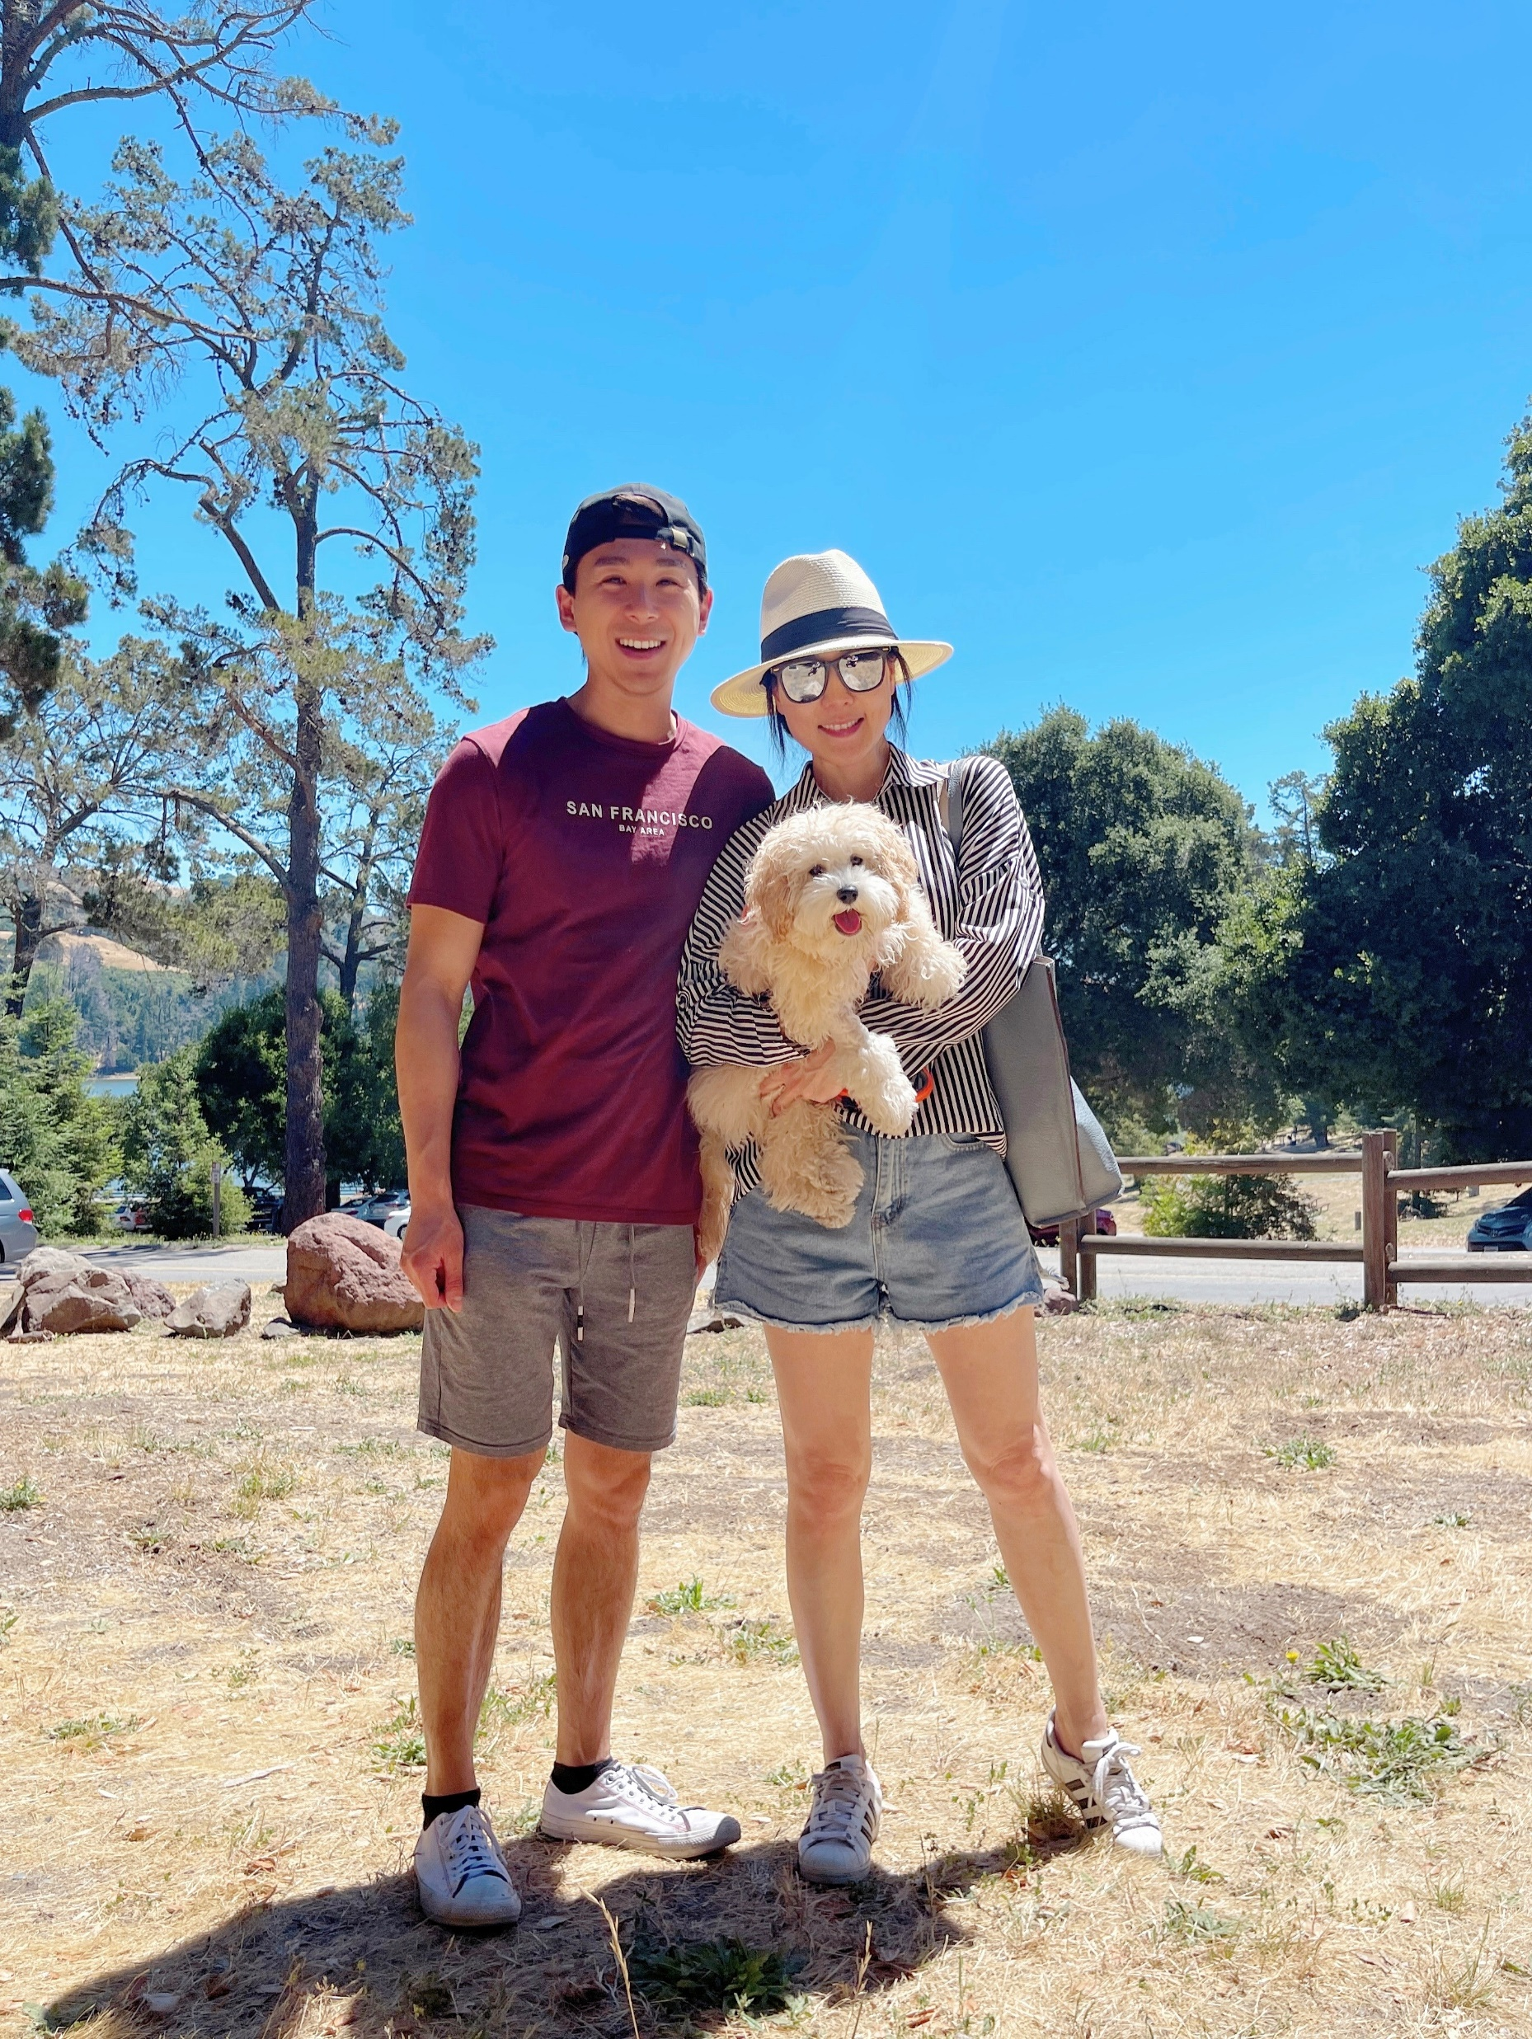
Randy Pang - 彭珞琮
Alice Pang - 謝婉琳
Bubbles – 泡泡

Slide 25


Slide 26
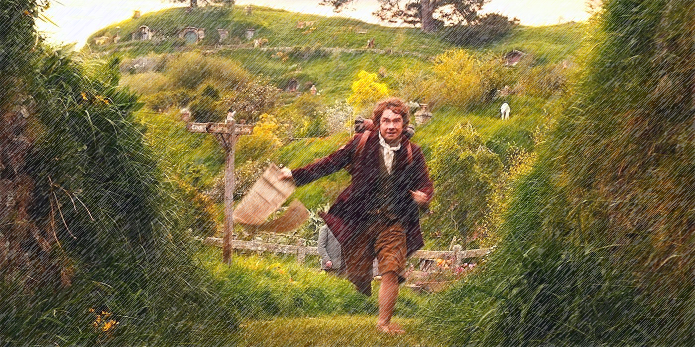

Slide 27
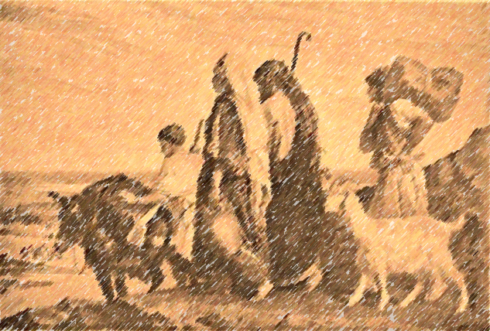

“In the days when the judges ruled there was a famine in the land, and a man of Bethlehem in Judah went to sojourn in the country of Moab, he and his wife and his two sons.” (Ruth 1:1)
“ 當士師秉政的時候，國中遭遇饑荒。在猶大的伯利恆，有一個人帶着妻子和兩個兒子往摩押地去寄居。” (路得記 1:1)

Slide 28
Pattern of “Famine in the Land” / “國中遭遇饑荒” 的模式
Naomi’s Family
“In the days when the judges ruled there was a famine in the land…” (Ruth 1:1)
Abram and Sarai in Egypt
Now there was a famine in the land. So Abram went down to Egypt to sojourn there, for the famine was severe in the land. (Genesis 12:10)
Joseph’s Brothers in Egypt
Thus the sons of Israel came to buy among the others who came, for the famine was in the land of Canaan. (Genesis 42:5)

Slide 29
“Do not call me Naomi; call me Mara (which means bitter), for the Almighty has dealt very bitterly with me. I went away full, and the Lord has brought me back empty. Why call me Naomi, when the Lord has testified against me and the Almighty has brought calamity upon me?” (Ruth 1:20-21)
“拿俄米對她們說：「不要叫我拿俄米，要叫我瑪拉，因為全能者使我受了大苦。 我滿滿地出去，耶和華使我空空地回來。耶和華降禍與我；全能者使我受苦。既是這樣，你們為何還叫我拿俄米呢？」”
(路得記 1:20-21)

Slide 30
When our lives fall apart, we lose our ability to hope.
當生活分崩離析，我們失去了盼望的能力

Slide 31
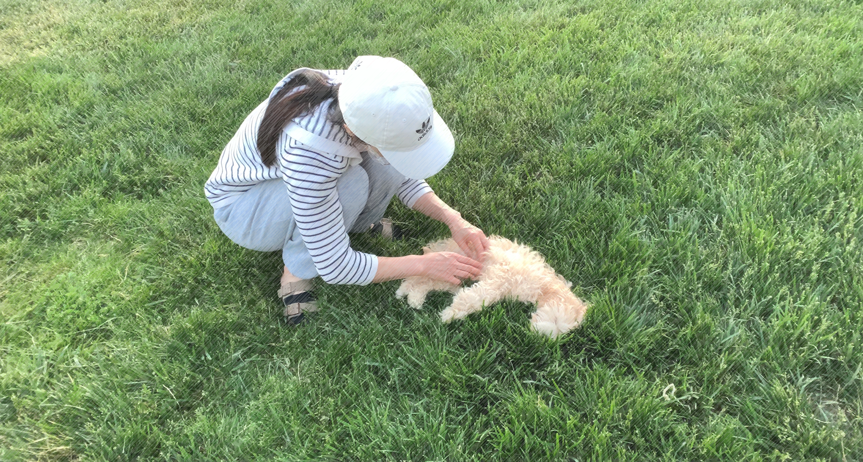

Slide 32
2. Our God is well known for turning tragedy into triumph.
我們的神是以化悲劇為勝利而聞名

Slide 33
“Do not urge me to leave you or to return from following you. For where you go I will go, and where you lodge I will lodge. Your people shall be my people, and your God my God. Where you die I will die, and there will I be buried. May the Lord do so to me and more also if anything but death parts me from you.” (Ruth 1:16-17)
在哪裏死，
“路得說：「不要催我回去不跟隨你。你往哪裏去，我也往那裏去；你在哪裏住宿，我也在那裏住宿；你的國就是我的國，你的神就是我的神。 你在哪裏死，我也在那裏死，也葬在那裏。除非死能使你我相離！不然，願耶和華重重地降罰與我。」”路得記 1:16-17

Slide 34
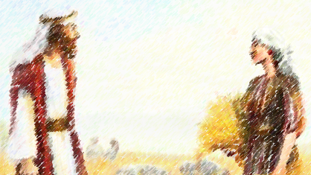
“Let her glean even among the sheaves, and do not reproach her. And also pull out some from the bundles for her and leave it for her to glean, and do not rebuke her.” (Ruth 2:15-16)
“她起來又拾取麥穗，波阿斯吩咐僕人說：「她就是在捆中拾取麥穗，也可以容她，不可羞辱她； 並要從捆裏抽出些來，留在地下任她拾取，不可叱嚇她。」” (路得記 2:15-16)

Slide 35
Then Naomi took the child and laid him on her lap and became his nurse. And the women of the neighborhood gave him a name, saying, “A son has been born to Naomi.” They named him Obed. He was the father of Jesse, the father of David. (Ruth 4:16–17)
“拿俄米就把孩子抱在懷中，作他的養母。 鄰舍的婦人說：「拿俄米得孩子了！」就給孩子起名叫俄備得。這俄備得是耶西的父，耶西是大衛的父。” (路得記 4:16-17)

Slide 36
3. We can hope again when we realize God’s
picture of hope is fuller than ours.
當我們明白神盼望的圖畫比我們的更豐滿時，
我們可以再次的懷抱希望

