Slide 1
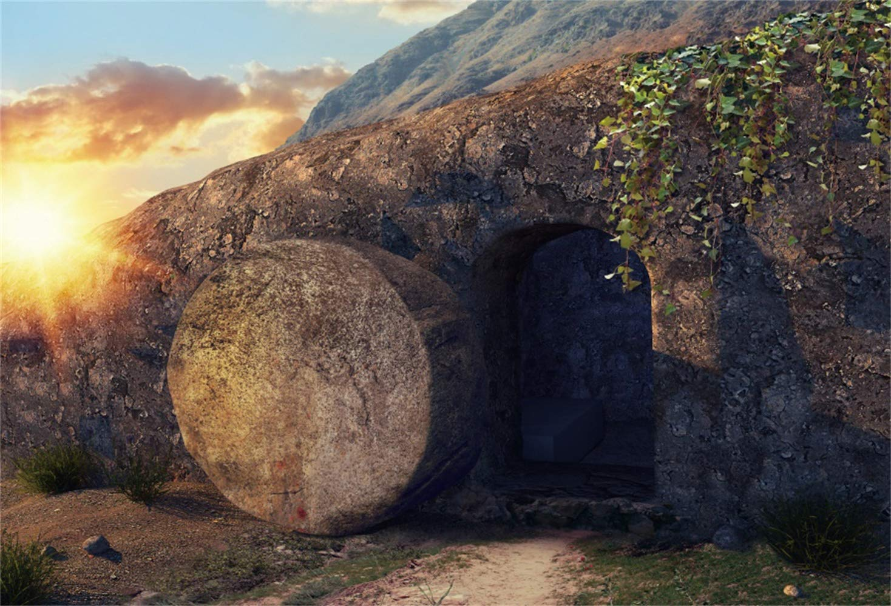
“The Reality of the Risen Christ”
“基督复活的真实”
Easter Sunday, April 9, 2023
David Nguyen 牧师

Slide 2
Three Universally Accepted FACTS
1) The tomb was discovered empty. 坟墓被发现是空的
2) Jesus’ disciples had real experiences with one whom they believed was the risen Christ. 耶稣的门徒与他们相信是复活的基督有真实的经历
3) The church grew from the disciples’ resurrection-centered preaching beginning in Jerusalem. 教会因门徒在耶路撒冷开始的以复活为中心的传讲而开始发展

Slide 3
“Was the Tomb Empty?” “坟墓是空的吗?”
The Objection: “What if the body was just stolen?”
异议：“如果尸体只是被偷了呢？”
  Guarded by Roman soldiers 由罗马士兵看守
  Sealed by extremely heavy stone 被极重的石头封印
  The mention of the first witnesses being women提到第一批证人是妇女

Slide 4
“Was the Tomb Empty?” “坟墓是空的吗?”
There’s no incentive for any group to steal the body.
任何团体都没有去偷尸体的动机.
The Romans: Don’t want to encourage uprising 罗马人：不想鼓励反叛暴动
The Jews: Don’t want to encourage belief in a risen “false Messiah” 犹太人：不想鼓励人们相信复活的“假弥赛亚”

Slide 5
“Was the Tomb Empty?” “坟墓是空的吗?”
There’s no incentive for any group to steal the body.
任何团体都没有去偷尸体的动机.
The Followers of Jesus: Why suffer and die for something they KNEW was a lie? 耶稣的门徒：为什么要为他们明知是谎言的事情而受苦和死亡？
There is no plausible explanation for an empty tomb besides the fact of the resurrection. 除了复活的事实之外，没有对空墓的合理解释

Slide 6
Three Universally Accepted FACTS
1) The tomb was discovered empty. 坟墓被发现是空的
2) Jesus’ disciples had real experiences with one whom they believed was the risen Christ. 耶稣的门徒与他们相信是复活的基督有真实的经历
3) The church grew from the disciples’ resurrection-centered preaching beginning in Jerusalem. 教会因门徒在耶路撒冷开始的以复活为中心的传讲而开始发展

Slide 7
“Did Jesus Really Appear to the Disciples?” “耶稣真的向门徒显现吗?”
The Objection: “What if the disciples were just lying about seeing Jesus?” 异议：“如果门徒只是谎称见到耶稣呢？”
  There’s no incentive to lie if they were being persecuted and killed for what they knew was a lie. 如果他们为了谎言而受到迫害和杀害，就没有撒谎的动机。
“What if the disciples were just hallucinating?”
“如果门徒只是产生幻觉呢?”
  Hallucinations aren’t group experiences. 幻觉不是集体经历

Slide 8
Three Universally Accepted FACTS
1) The tomb was discovered empty. 坟墓被发现是空的
2) Jesus’ disciples had real experiences with one whom they believed was the risen Christ. 耶稣的门徒与一位他们相信是复活的基督有真实的经历
3) The church grew from the disciples’ resurrection-centered preaching beginning in Jerusalem. 教会因门徒在耶路撒冷开始的以复活为中心的传讲而开始发展

Slide 9
“Did the story just arise from Jewish myths?”
“这个故事是否只是源于犹太传说?”
The Objection: “Jesus’ followers just created a new religion like many others did throughout history.”
异议：“耶稣的门徒只是创立了一种新的宗教，就像历史上许多其他人所做的那样。”
No Jewish concept of ONE man being resurrected in the middle of history.
犹太人没有一个人在历史上复活的概念
Worshiping a man as God is unthinkable for Jews.
把一个人作为上帝来崇拜对犹太人来说是不可想象的

Slide 10
“Did the story just arise from Jewish myths?”
“这个故事是否只是源于犹太传说?”
…unless Jesus’ resurrection proved his identity and his claims, and they couldn’t deny it.
…除非耶稣的复活证明了他的身份和他的主张，他们无法否认

Slide 11
The Reality of the Risen Christ
“If in Christ we have hope in this life only, we are of all people most to be pitied. But in fact Christ has been raised from the dead, the firstfruits of those who have fallen asleep.
“我们若靠基督，只在今生有指望，就算比众人更可怜。但基督已经从死里复活，成为睡了之人初熟的果子。

Slide 12
The Reality of the Risen Christ 基督复活的真实
For as by a man came death, by a man has come also the resurrection of the dead. For as in Adam all die, so also in Christ shall all be made alive.”
死既是因一人而来，死人复活也是因一人而来。在亚当里众人都死了。照样，在基督里众人也都要复活。”
(1 Cor 15:19-22 ESV) (林前15:19-22 )

