Slide 1
青春期家長
生命的銳變

Slide 2


Slide 3
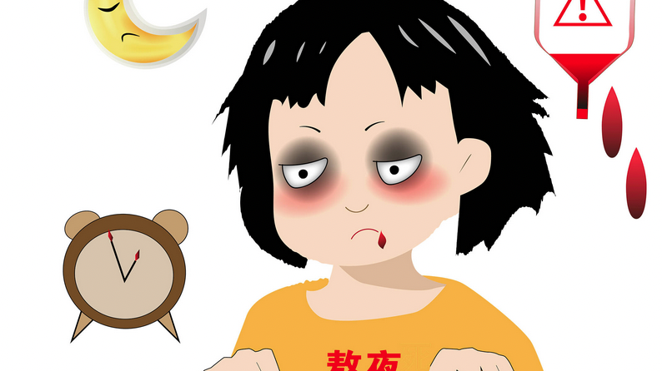

Slide 4
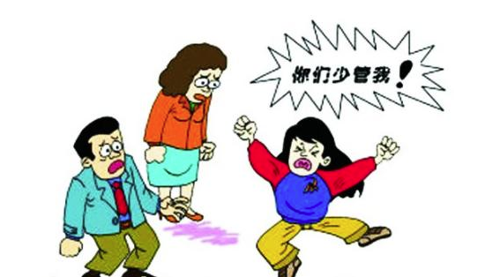

Slide 5
關係是傷也是藥，良好的親子關係，可以幫助我們和孩子成為更好的自己

Slide 6

處於青春期的孩子
渴望友誼
渴望理解
渴望自由

Slide 7
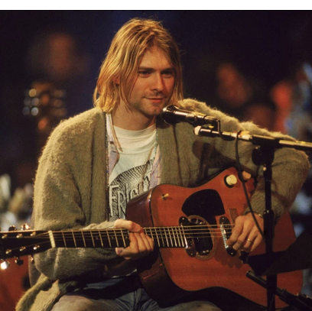
Kurt Cobain 1967-1994
When Kurt Cobain was nine years old, his parents divorced. He later said the divorce had a profound effect on his life, and his mother noted that his personality changed dramatically; Cobain became defiant and withdrawn. In a 1993 interview, he said he felt "ashamed" of his parents as a child, and had desperately wanted to have a "typical family ... I wanted that security, so I resented my parents for quite a few years because of that." –Nirvana singer and guitarist

Slide 8
作為基督徒，我們信仰的基礎建立在人與神的關係（垂直）、人與人之間的關係（橫向）

Slide 9

一、個人生命的改造 (Reconstruct)
回顧自己生命的經歷
重審自己與生命之主的關係
改變自己、接受不完美的我

Slide 10
回顧自己生命的經歷

Slide 11
重審自己與生命之主的關係
Goal Seeking? Or God Seeking?
Self-regulating? Or Submissive to the Lordship?
Self-actualization? Or Denying Self?
Me First? Or God First?

Slide 12
改變自己、接受不完美的我
勇於面對和認識真實的自己
學習控制自己的情緒
神會用我們的孩子來改變我們

Slide 13

二、與青少年關係的重建 (Rebuild)
重建彼此的信任
重建彼此的溝通
放手、給予理解和自由

Slide 14

學習在生活中與你的孩子建立關係
好好傾聽孩子的心聲
允許孩子有不同的發洩的出口
與孩子分享你自己的故事
避免忽視孩子真實的感受
拉近彼此的距離，尋找交接點

Slide 15
三、反省、更新、重啟
(Reflect – Renew – Restart)
反省我們的目的 ，花時間與神獨處
藉著神的話語來更新開啟新的人生觀
重啟但不操之過急 already but not yet

Slide 16
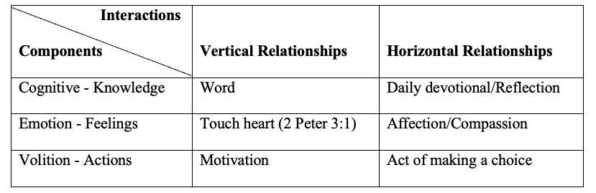
每日個人與神、人與人互動的三重組合：認知、情感、意志

Slide 17
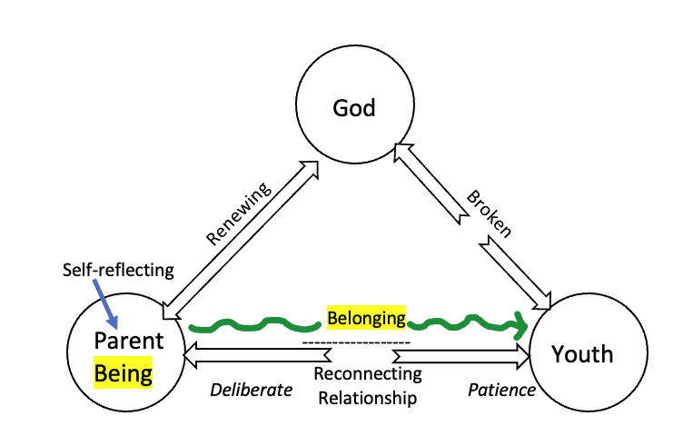

Slide 18
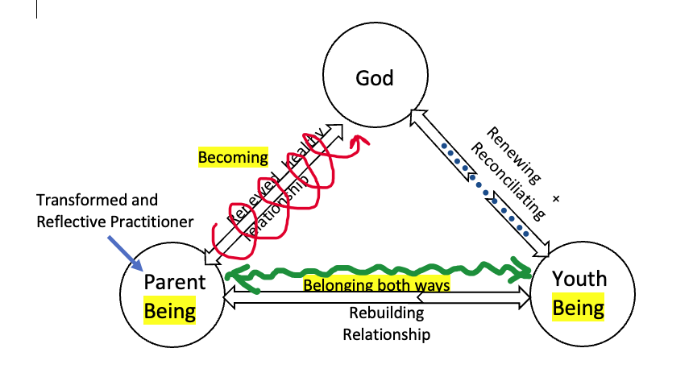

Slide 19
改變先從自己開始、藉著神的力量來翻轉你的生命
生命影響生命、來證明你的信仰是真實的 ！

