Slide 1
Astonishing Authority
令人驚訝的權柄
Mark 1:21-34
(馬可 1:21-34)

Slide 2
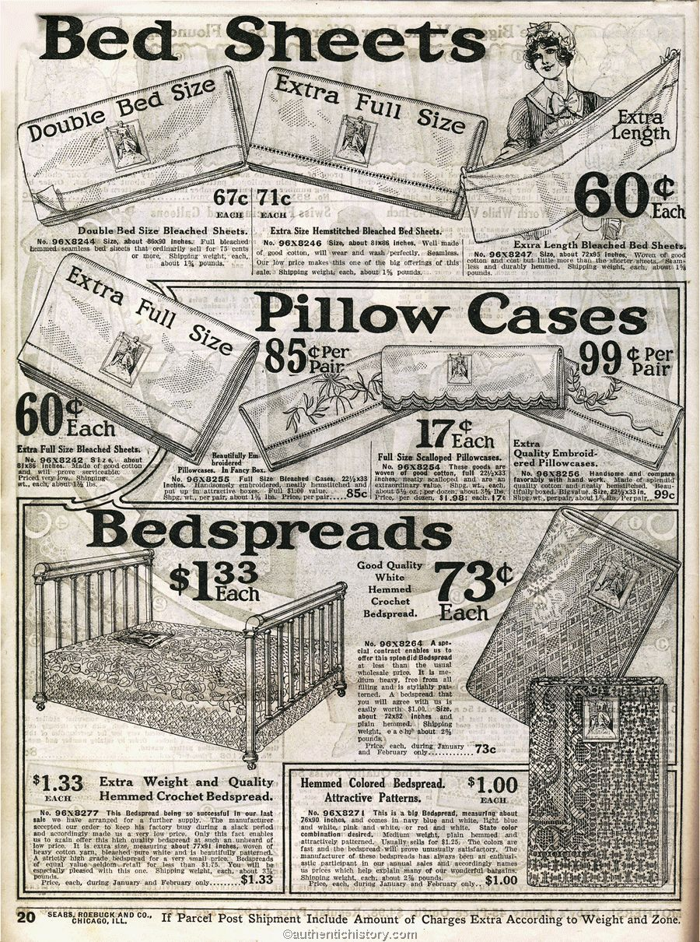
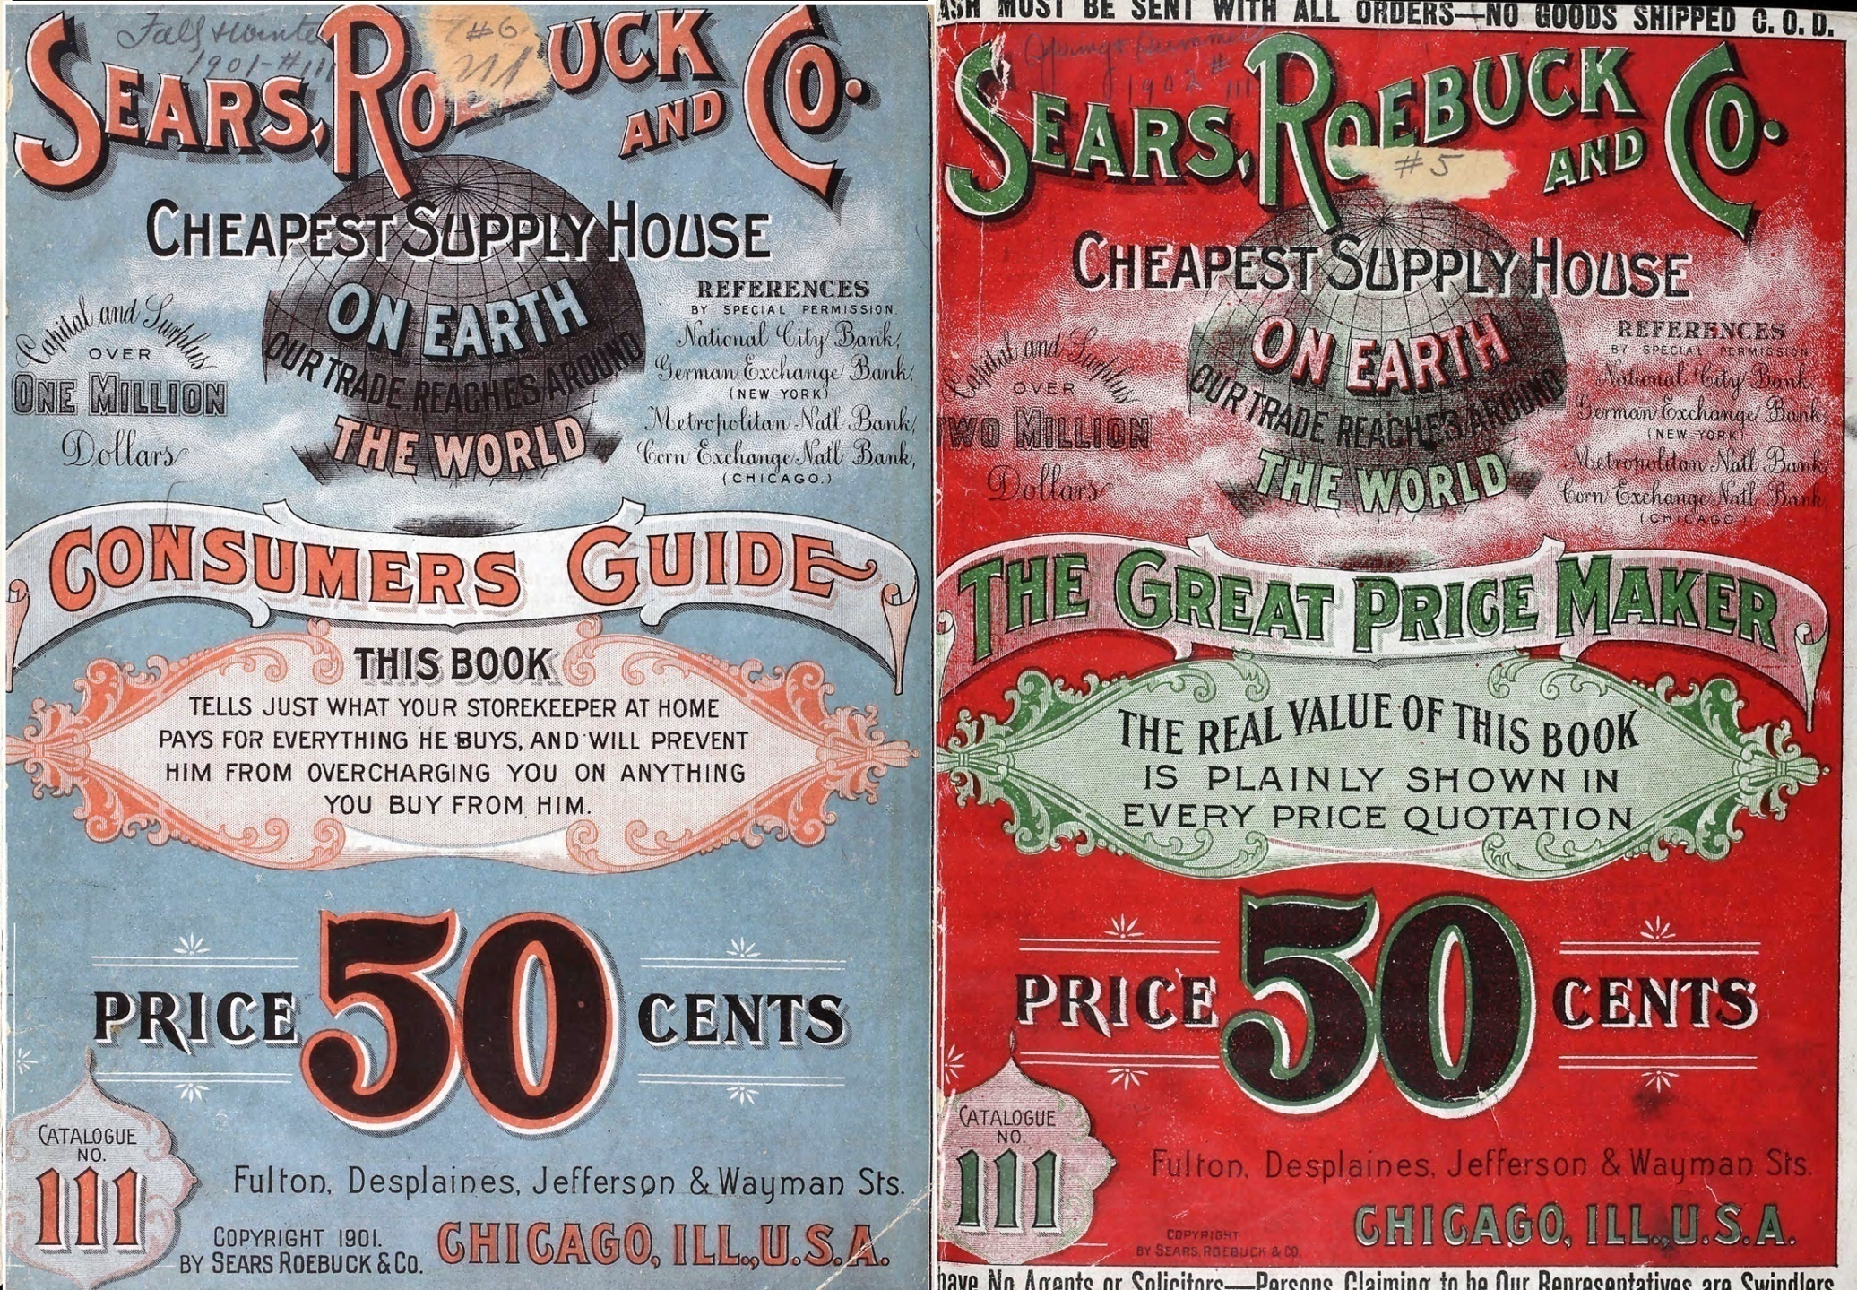

Slide 3
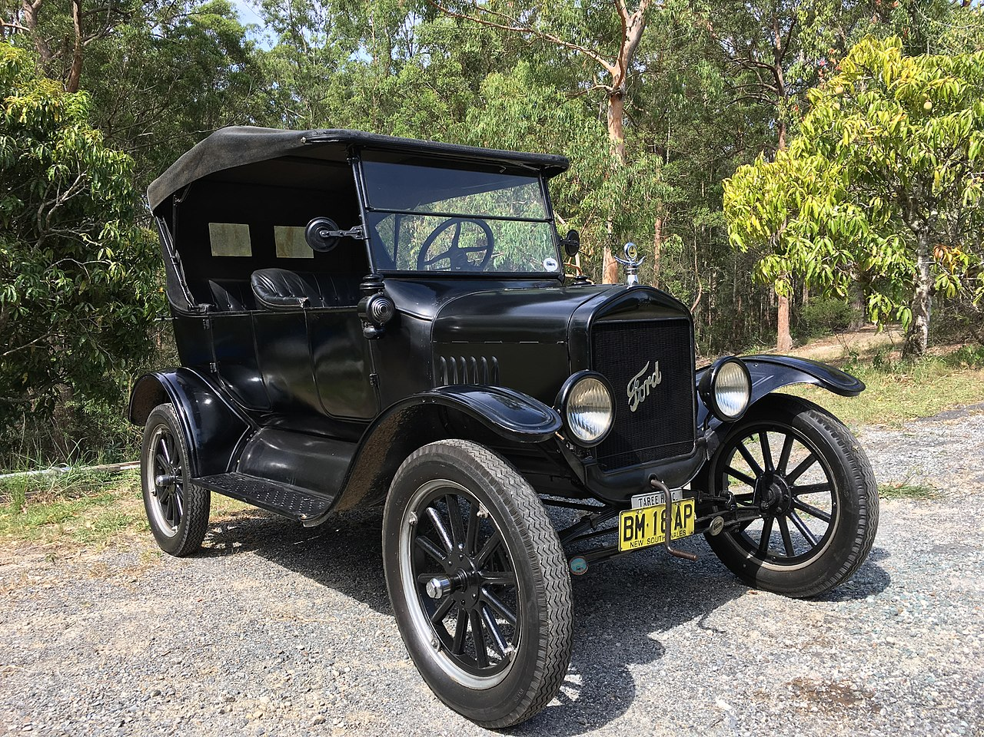
Ford Model T (1908)

Slide 4
Authority over Truth (Mark 1:21-22)
²¹ And they went into Capernaum, and immediately on the Sabbath he entered the synagogue and was teaching.
²² And they were astonished at his teaching, for he taught them as one who had authority, and not as the scribes.

Slide 5
在真理上的權柄 (馬可 1:21-22)
²¹到了迦百農，耶穌就在安息日進了會堂教訓人,
²²眾人很希奇他的教訓。因為他教訓他們，正像有權柄的人，不像文士

Slide 6
Authority over the Spiritual
(Mark 1:23-28)
²³ And immediately there was in their synagogue a man with an unclean spirit. And he cried out,
²⁴ "What have you to do with us, Jesus of Nazareth? Have you come to destroy us? I know who you are-- the Holy One of God.“

Slide 7
在屬靈上的權柄 (馬可 1:23-28)
²³在會堂裡有一個人，被污鬼附著。他喊叫說
²⁴拿撒勒人耶穌，我們與你有甚麼相干，你來滅我們麼。我知道你是誰，乃是神的聖者。

Slide 8
Authority over the Spiritual
(Mark 1:23-28)
²⁵ But Jesus rebuked him, saying, "Be silent, and come out of him!"
²⁶ And the unclean spirit, convulsing him and crying out with a loud voice, came out of him.

Slide 9
在屬靈上的權柄 (馬可 1:23-28)
²⁵耶穌責備他說，不要作聲，從這人身上出來罷。
²⁶污鬼叫那人抽了一陣瘋，大聲喊叫，就出來了。

Slide 10
Authority over the Spiritual
(Mark 1:23-28)
²⁷ And they were all amazed, so that they questioned among themselves, saying, "What is this? A new teaching with authority! He commands even the unclean spirits, and they obey him."
²⁸ And at once his fame spread everywhere throughout all the surrounding region of Galilee.

Slide 11
在屬靈上的權柄 (馬可 1:23-28)
²⁷眾人都驚訝，以致彼此對問說，這是甚麼事，是個新道理阿。祂用權柄吩咐污鬼，連污鬼也聽從了祂。
²⁸耶穌的名聲，就傳遍了加利利的四方。

Slide 12
Authority over the Physical
(Mark 1:29-31)
²⁹ And immediately he left the synagogue and entered the house of Simon and Andrew, with James and John.
³⁰ Now Simon's mother-in-law lay ill with a fever, and immediately they told him about her.
³¹ And he came and took her by the hand and lifted her up, and the fever left her, and she began to serve them.

Slide 13
在身體上的權柄 (馬可 1:２９－３１)
²⁹他們一出會堂，就同著雅各約翰，進了西門和安得烈的家。
³⁰ 西門的岳母，正害熱病躺著。就有人告訴耶穌。
³¹ 耶穌進前拉著她的手，扶她起來，熱就退了，她就服事他們。

Slide 14
Conclusion (Mark 1:32-34)
³² That evening at sundown they brought to him all who were sick or oppressed by demons.
³³ And the whole city was gathered together at the door.
³⁴ And he healed many who were sick with various diseases, and cast out many demons. And he would not permit the demons to speak, because they knew him.

Slide 15
結語 (馬可 1:32-34)
³² 天晚日落的時候，有人帶著一切害病的，和被鬼附的，來到耶穌跟前。
³³ 合城的人都聚集在門前。
³⁴耶穌治好了許多害各樣病的人，又趕出許多鬼，不許鬼說話，因為鬼認識祂。

